Slide 1
IMPLICIT BIAS IN THE LEGAL PROFESSION, THE WORKPLACE, AND THE COMMUNITY– RECOGNIZING IT AND INTERRUPTING IT IN OURSELVES AND OTHERS
Karen Steinhauser
The Law Office of Karen Steinhauser LLC
www.steinhauserimplicitbias.com

Slide 2
Implicit Bias video
https://www.americanbar.org/news/abanews/aba-news-archives/2016/02/hidden_injusticebi.html
https://player.vimeo.com/video/165006635

Slide 3
What is Implicit Bias?
IMPLICIT BIAS refers to the attitudes or stereotypes that affect our understanding, actions, and decisions in an unconscious manner.
Kirwan Institute – Ohio State University
IMPLICIT BIAS is a term of art referring to relatively unconscious and relatively automatic features of prejudiced judgment and social behavior
Stanford Encyclopedia of Philosophy

Slide 4
ABA Rule of Professional Conduct 8.4(g)
It is professional misconduct for a lawyer to:
Engage in conduct that the lawyer knows or reasonably should know is harassment or discrimination on the basis of race, sex, religion, national origin, ethnicity, disability, age, sexual orientation, gender identity, marital status or socioeconomic status in conduct related to the practice of law….

Slide 5
Model rule 8.4 – Comment 4
Conduct related to the practice of law includes representing clients; interacting with witnesses, coworkers, court personnel, lawyers and others while engaged in the practice of law; operating or managing a law firm or law practice; and participating in bar association, business or social activities in connection with the practice of law….

Slide 6
COLORADO RULE OF PROFESSIONAL RESPONSIBILITY 8.4 (g)
It is professional misconduct for a lawyer to:
(g) engage in conduct, in the representation of a client, that exhibits or is intended to appeal to or engender bias against a person on account of that person’s race, gender, religion, national origin, disability, age, sexual orientation or socioeconomic status, whether that conduct is directed to other counsel, court personnel, witnesses, parties, judges, judicial officers, or any persons involved in the legal process.

Slide 7
NEWLY ADOPTED COLORADO RULE OF PROFESSIONAL RESPONSIBILITY 8.4 (I)
(i) engage in conduct the lawyer knows or reasonably should know constitutes sexual harassment where the conduct occurs in connection with the lawyer’s professional activities.

Slide 8
COMMENT TO 8.4 (i)
“Sexual harassment may include, but is not limited to, sexual advances, requests for sexual favors, and other verbal or physical conduct of a sexual nature that a reasonable person would perceive as unwelcome. The substantive law of employment discrimination, including anti-harassment statutes, regulations, and case law may guide, but does not limit application of paragraph (i). “Professional activities” are not limited to those that occur in an attorney-client relationship.”

Slide 9
Rule 8.4 (g) and our ability to be an Effective Advocate
How do we define conduct related to the practice of law? (Batson)?
Does it make a difference whether we are in the courtroom or in the office?
What about mentor-mentee relationships and the law school environment?

Slide 10
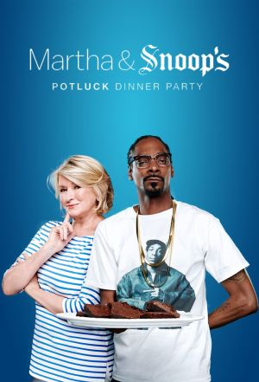
HOW DO I ANSWER THESE QUESTIONS AND WHY???
Who is the felon?
Who served prison time?
HAVING AN IMPLICIT BIAS DOES NOT MAKE YOU A BAD PERSON!!

Slide 11
Lena Olive Smith quote
“Perhaps the jurors were, with few exceptions, conscientious in their expressions of no race prejudice, yet it is common knowledge a feeling can be so dormant and subject to one’s sub-consciousness, that one is wholly ignorant of its existence.
But if the proper stimulus is applied it comes to the front end and more often than not, one is deceived in believing that it is justice speaking to him, when in fact it is prejudice, blinding him to all justice and fairness.”

Slide 12
IMPLICIT BIAS
Affects:
The Administration of Justice
The Public’s perception of you, your courthouse, your office, and your community
Your reputation
Can be perceived as:
racism, sexism, homophobia, classism, etc.
discrimination or harassment
THE IMPACT: IS HURTFUL!!!!!
CAN BE DEADLY!!!!!!!

Slide 13
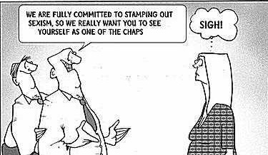
Acting Out Bias

Slide 14
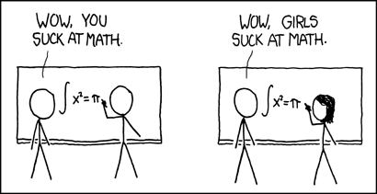
Reinforcing Bias With the “Experiment of One”
Experiment
Take-Away

Slide 15
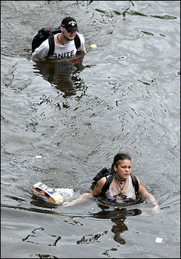
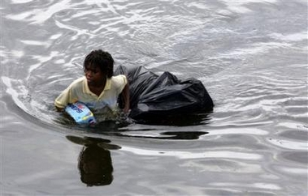
Unconscious Bias: In the News
AP - Tue Aug 30,11:31 AM ET AP caption: A young man walks through chest deep flood water after looting a grocery store in New Orleans on Tuesday, Aug. 30, 2005. Flood waters continue to rise in New Orleans after Hurricane Katrina did extensive damage when it made landfall on Monday.
(AP Photo/Dave Martin)
AFP/Getty Images - Tue Aug 30, 3:47 AM ET AFP/Getty Images caption: Two residents wade through chest-deep water after finding bread and soda from a local grocery store after Hurricane Katrina came through the area in New Orleans, Louisiana.
(AFP/Getty Images/Chris Graythen)

Slide 16
Implicit Association Test (IAT)
Measures the strength of associations between
Concepts
Evaluations
Stereotypes

Slide 17
Reflection of IAT test In small group, please discuss. Report back to entire group.
Were you surprised by the results of test? Explain.
How can having this bias impact you or others - in your workplace; your home environment?
How can you interrupt this bias?
Share a bias situation where you were a:
Victim, or
Witness, or
Participant.
How would you handle it now after tonight’s discussion?

Slide 18
HOW DO YOU RECOGNIZE THE BIAS?
Race
Gender
Religion
Culture
Profession
Appearance (weight, dress, accent)
Sophistication
Accent
Age
Sexual Identity?/Sexual Orientation
Others?
Notes:
If you can isolate it, you can recognize it.
If you can recognize it, you can pause and adjust your behavior
If you can adjust your behavior, you will act on the basis of will, not cluelessness
Fear:

Slide 19
Be aware of the signals you give:
Facial Expressions
Dismissing the idea of one only to embrace it when offered by another (or vice versa)
Leaving someone off a group e-mail
Addressing some employees by chummy nicknames
Continually mispronouncing a co-worker, staff, opposing party, another student’s or juror’s name
Mixing up individuals of same race, ethnicity or gender with another of the same.

Slide 20
Other signals:
Calling some people by last name and others by first name
Commenting on someone’s clothing or appearance
Making assumptions about who the defendant is, the attorney or clerk
Making assumptions about who the first chair is
RECOGNIZING THAT IT DOES MATTER

Slide 21
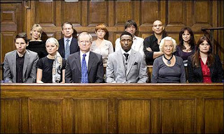
What Do You See? (What Do They See?)

Slide 22
HOW DO YOU INTERRUPT BIAS?
Recognize the bias
In yourself
In others
Understand the source of the bias
Confront the bias

Slide 23
Should I Say Something?
Awkward
Risky?
Beneficial?
WHO SHOULD I SAY SOMETHING TO?
Implicit Bias Is Not “Cured”
Awareness Enables Self-Correction
Developing The Habit of Recognizing “Moments” for Implicit Bias That Would Hurt
Acknowledging and Neutralizing

Slide 24
Pass It On
When you see it,
Call it out
Choose how

Slide 25
Interrupting Implicit Bias
http://www.techtimes.com/articles/40275/20150317/much-to-say-about-diversity-google-chief-eric-schmidt-repeatedly-interrupted-female-co-panelist-at-sxsw.htm
Much To Say About Diversity: Google Chief Eric Schmidt Repeatedly Interrupted Female Co-Panelist At SXSW
By Menchie Mendoza, Tech Times | March 17, 8:35 AM
Interrupt the bad behavior!
Notes:
Eric Schmidt had reportedly attended the SXSW music and technology festival in Texas where he, along with United States Chief Technology Officer and former Google senior staffer Megan Smith, talked about gender equality in the tech industry. During the discussion, Schmidt was challenged by an attendee who observed how he repeatedly interrupted co-panelist Smith.
Another panelist, Walter Isaacson, who is an acclaimed biographer of Steve Jobs, was also observed to have repeatedly interrupted their female co-panelist.
When the Q&A session started, one member of the audience asked both men if they were aware that they were displaying their own unconscious bias when they interrupted Smith.
The attendee who popped the question was Judith Williams, head of the Global Diversity and Talent Programs department of Google.

Slide 26
FINAL THOUGHTS
Assessment: acknowledge your personal biases and understand what triggers them
Slow down!!! Don’t just rely on your gut to make decisions.
Be aware of who/how often you engage in conversation with people who are different than you
Surround yourself with a diverse mix of cultural and social situations/individuals; actively expose yourself to counter stereotypical examples
Find commonalities
Share your own experiences with others
Educate others about the elements of an inclusive work, school and community environment.

